Slide 1
Town of Hull Overview FY25 Draft Budget
Select Board &
Advisory board
February 21, 2024

Slide 2
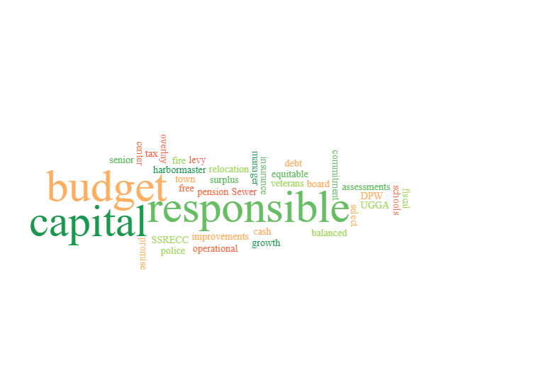
PRESENTATION OVERVIEW
Annual Budget Framework
Financial Reserves
Budget Process
Net State Aid
Revenues
Expenditures
FY25 Highlights

Slide 3
Annual Budget Framework Objectives
Financial
Policies
Provide Guidance & Process
Assign Responsibilities
Capital Improvement
Plan
Enable Capital Investment
Sustainable Financial Strategy
Long Range
Financial Forecast
Project Available Funding &
Prepare for Future Expenditures
Transparency
Adopt MGL c. 41 §106B
GFOA Distinguished Budget Award/Best Practices

Slide 4
FUNDING SECURITY &
FINANCIAL RESERVES
ESTABLISH:
Opioid Settlement Special Purpose Stabilization Fund
Predetermined Annual Award
Capital Stabilization Fund
2-3% of annual general fund budget
CONSISTENTLY FUND:
General Stabilization Fund
Maintain a min. balance of 3-5% of the operating budget

Slide 5
Budget Process
Department Budgets & Capital Requests
Determine Revenue & Expenditure Assumptions
Assess Capital
Improvement Priorities/
Needs
Present Balanced FY25 Draft Budget 2/21/2024
Department Budget Meetings

Slide 6
Projected Net State Aid
Category | FY24 Cherry Sheet | FY25 Governor’s Budget | Difference
Education | $4,130,018 | $4,114,477 | ($15,541)
General Government | $2,776,418 | $2,863,367 | +$86,949
Assessments/ Charges | $857,176 | $876,652 | ($19,476)
Net |  |  | $51,932

Slide 7
Preliminary »Draft Budget Overview
FY25 General Fund Budget | 1/24/2024 Preliminary | 2/21/2024 Draft
Revenues | $51,615,430 | $51,934,214
Expenses | $52,382,840 | $51,933,139
Surplus (Deficit) | ($767,410) | $1,075

Slide 8
REVENUE SOURCES
Property Taxes - 72%
State Aid - 14%
Local Receipts -14%

Slide 9
EXPENDITURES
Operational Budget – 61%
Insurances - 16%
Pensions - 9%
Debt & Interest – 7%
Intergovernmental & Assessments – 3%
Capital Improvements – 1%
Other (Overlay, Snow & Ice) - <1%
Townwide - <1%

Slide 10
Operational & Capital Expense Highlights
OPERATIONAL
CAPITAL
4 Collective Bargaining Agreements
Staff Increases HFD – 2 FF Paramedics/EMT Positions
Legal Staff Model Adjustment
Contractual Buyouts
Relocation/Closure of Town Hall/Senior Center to MMS (SB)
MMS Maintenance/Repairs
Library Boiler Replacement
Online permitting and general government software
Seawall Repair & Maintenance
Ambulance Replacement
Establish a Capital Stabilization Fund
Increase General Stabilization Fund
Public Safety Facilities Feasibility Study

Slide 11
Fiscal Year 2025 Budget Worksheet
Department: Capital
 | Description |  | FY25 Request | Town Manager Recommend | Advisory Board Recommend
Department
Town Wide
 | Townwide Line Painting |  | 45,000 | 45,000
 | Town Wide Seawall Program |  | 50,000 | 50,000
 | Straits Pond Mitigation |  | 45,000 | 45,000
 | War Memorial Repair & Updates |  | - | -
 | Town Clerk Records Retention |  | 10,000 | 10,000
 | High Speed Voting Machine(s) |  | 10,000 | 10,000
 | Town Meeting Clickers |  | 16,000 | 16,000
 | On Line Permitting System |  | 50,000 | 50,000
 | Town Owned Building Assessment |  | - | -
 | Memorial School FFE |  | - | -
 | Memorial School Move |  | - | -
Information Technology
 | System Replacement/Upgrade |  | 140,000 | 140,000
Police
 | Replacement Equipment-Police Vehicles |  | 130,000 | 130,000

Slide 12
Fiscal Year 2025 Budget Worksheet
Department: Capital
 | Description |  | FY25 Request | Town Manager Recommend | Advisory Board Recommend
Fire
 | Replacement Hydrants |  | 10,000 | 10,000
 | Command Vehicles (2) |  | 120,000 | 120,000
School
 | System Replacement/Upgrade |  | 40,000 | 40,000
DPW
 | Replacement Equipment |  | 20,000 | 20,000
Council on Aging
 | Building Repairs |  | 54,000 | 54,000
Library
 | Boiler Replacement |  | 25,000 | 25,000
Total Capital Budget Total |  |  | $765,000 | $765,000 | $0

Slide 13
FY25/26 GOALS
FINALIZE FISCAL POLICIES
Establish capital outlay committee and capital planning process
Increase online presence and accessibility
Conduct wage and classification studies

Slide 14
Next Steps
Continue to refine budget
Department budget meetings with advisory
board
finalize budget
Select Board signs Town meeting warrant –
March 27th
Annual Town Meeting – May 6th

